Slide 1
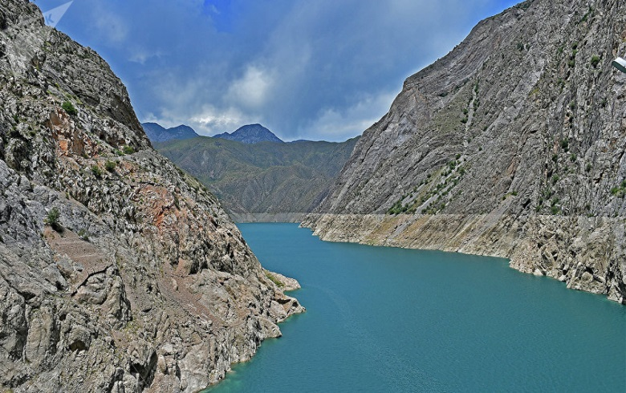
SUUSAMYR-KOKOMEREN HPP CASCADE
Brief information Project financing for the construction of 3 HPPs with a total installed capacity of 1,305 MW and average annual output of 3,317 million kWh includes: Karakol -33 MW Kokomeren 1 -360 MW Kokomeren 2 - 912 MW
Project cost: 3.34 billion USD
Assignment of object to the territory Zhayil district of the Chui region and Toktogul district of the Jalal-Abad region.
Location and registration of the investment object Suusamyr-Kokomeren HPP cascade is located on the Kokomeren river inflow of which goes from Naryn river. Drainage area is 10400 sq. km, the length - 199 km. The average height of the pool is 2737 m. The highest average monthly temperature is 39 in Chaek village, the lowest temperature is minus 37
Objective of the project The project is aimed on increasing the energy capacity and generating electricity to cover growing demand in the energy system.
Final results of the project The amount of energy generated over the average long-term period will estimate 3317 million kWh with an average annual output.
The impact of the project on the environment The project has no negative impact on the environment.
Sources of debt repayment Funds from the sale of electricity
Plans for the sale of finished products Production and sale of electricity in the domestic and foreign markets
ºC

