Slide 1
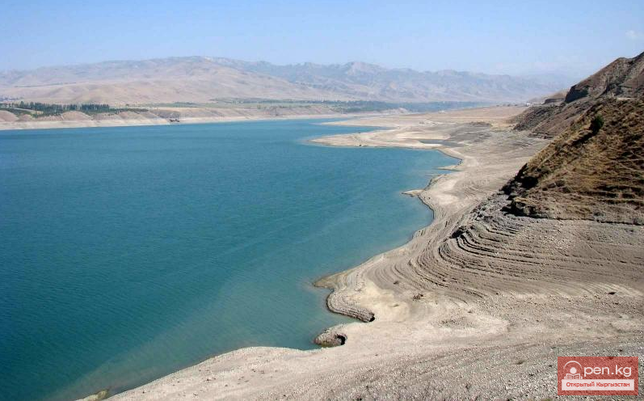
CONSTRUCTION OF PAPAN HPP
Brief information: The project provides the construction of a Small HPP with a capacity of 20 MW, a unit capacity of 10 MW Key project facts: According to pre-feasibility study project developed by “Mercados -Energy Markets International (Spain)” company, the project cost is 28 million US dollars
Location: Kyrgyz Republic, Osh region, Kara-Suu District, Papan reservoir on Ak-Buura river
Project goals: The project is aimed on increasing the energy capacity and generating electricity to cover growing demand in the energy system.
Power generation Volume of energy generated by the two units for an average long-term period will amount to an average annual output of 106 million kWh.
Term construction: 3 years
Reservoir capacity 260 million m3 Maximum volume of water flow 345 m3 / s Minimum volume of water consumption 2.4 m3 / s
Estimated water consumption at hydroelectric power station 45 m3 / s
Heads: Maximum 80 m Minimum 40 m Estimated 77m
The project has no negative impact on the environment

