Slide 1
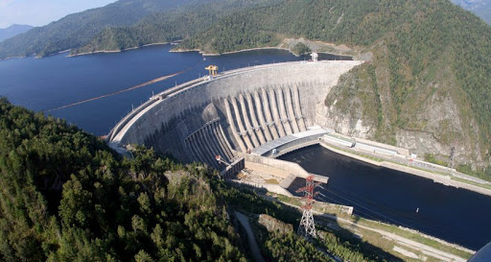
CONSTRUCTION OF KULANAK HPP CASCADE
Brief information: Investment of the project provides for the construction of 5 HPPs with a total installed capacity of 439 MW and an average annual output of 2667.8 million kWh At-Bashinskaya - 135 MW; Uchkunskaya - 88 MW; Aktalinskaya - 38 MW; Dzhilanaryk-1 - 80 MW; Dzhilanaryk-2 - 98 MW. Key project facts:
Project cost: 2.78 billion USD
Location: the Kyrgyz Republic Naryn region, At-Bashinsky between the flow of At-Bashi and Ala-Buga rivers
Objectives of the project The project is aimed on increasing the energy capacity and generating electricity to cover growing demand in the energy system.
Final results of the project Average annual production of electricity is 2667.8 million kWh
Financial and economic forecast of the project: Forecast data will be determined after clarification on conditions of the project financing.
The impact of the project on the environment The project has no negative impact on the environment

