Slide 1
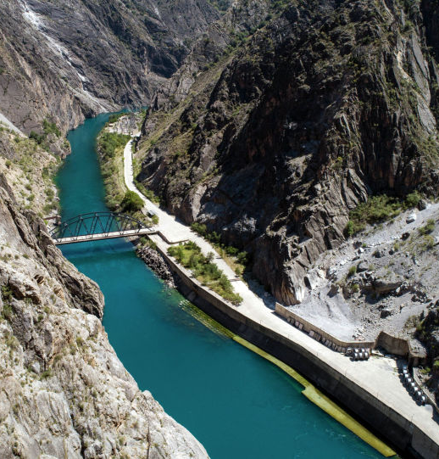
CONSTRUCTION OF AT - BASHY HPP CASCADE
Brief information: Financing project for the construction of 5 HPPs with a total installed capacity of 132.2 MW and average annual output of 753 million kWh, includes: Taldysu 1 - 20.0 MW; Taldysu 2 - 26.7 MW; Oytersken 1 - 28.5 MW; Oytersken 2 - 17.0 MW; Akjar - 40.0 MW.
Key project facts:
Location: the Kyrgyz Republic Naryn region, At-Bashy district. Project cost 1.61 billion USD
Objectives of the project The project is aimed on increasing the energy capacity and generating electricity to cover growing demand in the energy system.
Final results of the project Volume of energy generated by the two units for an average long-term period will amount to an average annual output of 753 million kWh.
Financial and economic forecast of the project: Forecast data will be determined after clarification on conditions of the project financing.
The project has no negative impact on the environment

