Slide 1
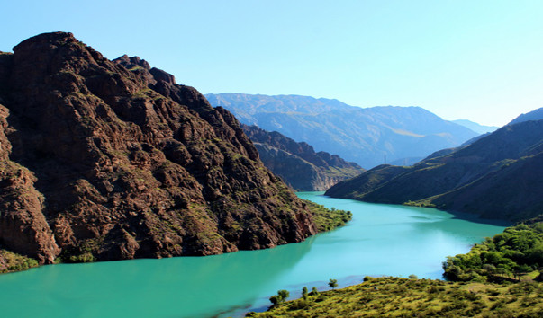
CONSTRUCTION OF ALA-BUKA HPP CASCADE
Brief information: Financing project for the construction of 4 HPPs with a total installed capacity of 414 MW and average annual output of 1,711 million kWh, includes: Arpanskaya -1- 136 MW Arpanskaya -2- 58 MW Makmalskaya - 112 MW Sazskaya - 108 MW
Key project facts:
Location: the Kyrgyz Republic, Naryn region, Ak-Talin district, Ala-Buga river. Total cost of the project 3.03 billion USD
Objectives of the project The project is aimed on increasing the energy capacity and generating electricity to cover growing demand in the energy system.
Final results of the project The amount of energy generated over the average long-term period will estimate 1.711 million kWh with an average annual output.
The construction project has no negative impact on the environment
Financial and economic forecast of the project: Forecast data will be determined after clarification on conditions of the project financing.
The project has no negative impact on the environment
Production and sale of electricity in the domestic and foreign markets.

