Slide 1
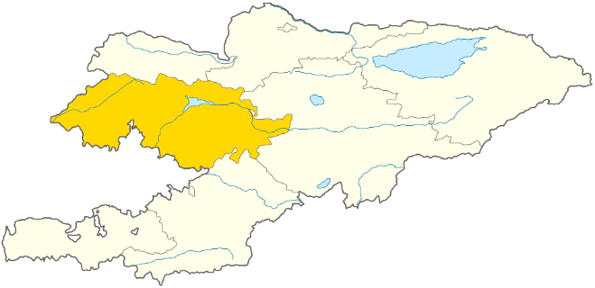
CONSTRUCTION OF KAMBAR-ATA HPP
Key facts
Brief information:
The dam side of the Kambar-Ata HPP-1 is located on the river Naryn in a V-shaped canyon, 14 km higher than Kambar-Ata HPP-2
Initiator: Cabinet of Ministers of the Kyrgyz Republic
Location: Jalal-Abad region
Project cost: 2 billion 869 million USD
Payback of the project: 10 years
Feasibility study developed (By SNC Corporation Lavalin International Inc.)
Construction infrastructure:
There is a production infrastructure that has been used during the construction of Kambarata HPP-2.
There are sufficient stocks of quarries of building materials for the construction of the dam of Kambarata HPP-1.
The object is in a close proximity to the highway of republican significance and power lines 500 kWh connecting the North and South of the country.
Normal retaining level, NPU, m | 1 198
Installed capacity, MW | 1860
Electricity generation, mln. kWh | 5640
Reservoir volume million m3 | 2730
HPP type | dam
Kambar-Ata HPP-3
Kambar-Ata HPP-2
Kambar-Ata HPP-1
Toktogul HPP
Kambar-ata HPP will become the most powerful hydropower power plant and the largest dam with a height of 265 m in Central Asia.
There are allocated land plots with the area 6318.8 ha
Key HPP for the full implementation of the project CASA-1000
Construction period -8 years

